Slide 1
Logistic Regression

Slide 2
Example
Question:
How many days per month do you drink at least two beers?
Would like to predict:
Have you ever driven after drinking?
Given
X = days per month of drinking two beers

Slide 3
Linear Regression
y is continuous
What if we wanted y to be a probability?

Slide 4
Linear Regression

Slide 5
From Linear to Logistic
Probabilities p are from 0 to 1
In Linear Regression, dependent variable y can take any value from
-infinity to +infinity
We need a way to map p to y and y to p

Slide 7
Logistic Regression

Slide 8
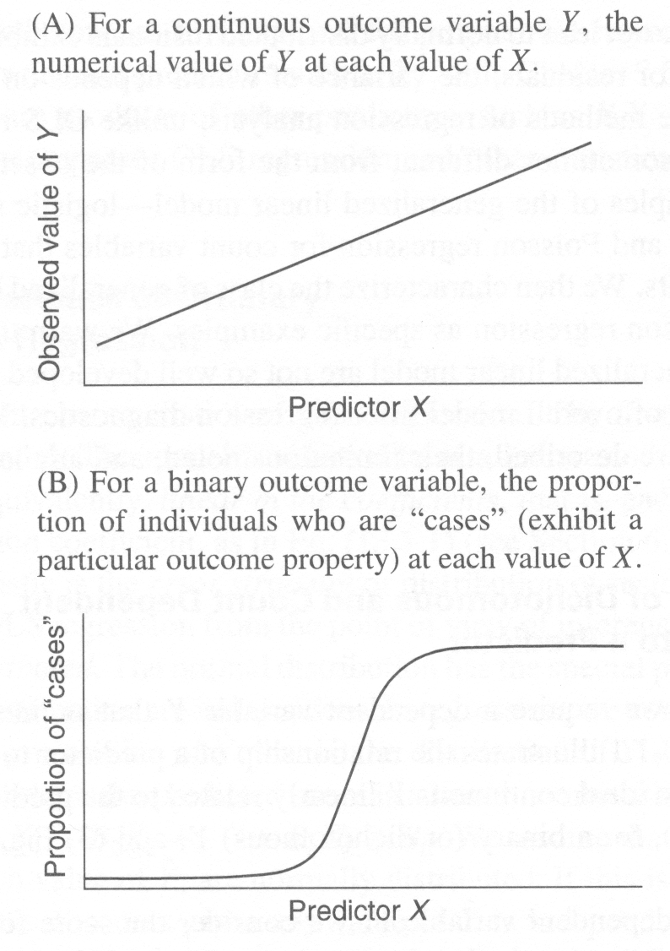
The logistic function

Slide 9
Odds
Team A play Team B
Your local gambling parlor gives .25 chance to A winning
What are the odds of A winning?

Slide 10
Odds
Team A play Team B
Your local gambling parlor gives 8:1 odds to A winning
What is the probability of A winning?

Slide 11
Logistic Regression

Slide 12
Logistic Regression

Slide 13
Example
Question:
How many days per month do you drink at least two beers?
Would like to predict:
Have you ever driven after drinking?
Given
X = days per month of drinking two beers

Slide 14
Example

Slide 15
Example
Probability of drunk driving if you never have more than two beers in a day?
Probability of drunk driving if you have more than two beers only one day in a month?
Notes:
X=0 .1748842 odds = .211951
X=1 .2040632 odds = .256381 log(ratio) = .19031
X=29 .9814323 odds = 52.85699
X=30 .9846005 odds = 63.93711 log(ratio) = .19031

Slide 16
Example
Probability of drunk driving if you have more than two beers 29 days in a month?
Probability of drunk driving if you have more than two beers 30 days in a month?

Slide 17
Interpretation of β1
Let:
odds1 = odds for value X (p/(1–p))
odds2 = odds for value X + 1 unit
Then:

Slide 18
Assumptions
The only “real” limitation on logistic regression is that the outcome must be discrete.
Ratio of cases to variables – using discrete variables requires that there are enough responses in every given category
Absence of multicollinearity
No outliers

Slide 19
Logistic Function
v2: b0 = -4.00
b1 = 0.05 (middle)
v3: b0 = -4.00
b1 = 0.15 (top)
v4: b0 = -4.00
b1 = 0.025 (bottom)
b1 → STEEPNESS

Slide 20
Logistic Function
v2: b0 = -3.00
b1 = 0.05 (top)
v3: b0 = -4.00
b1 = 0.05 (middle)
v4: b0 = -5.00
b1 = 0.05 (bottom)
b0 → LOCATION SHIFT

Slide 21
Pseudo R_squared for Logistic Regression

Slide 22
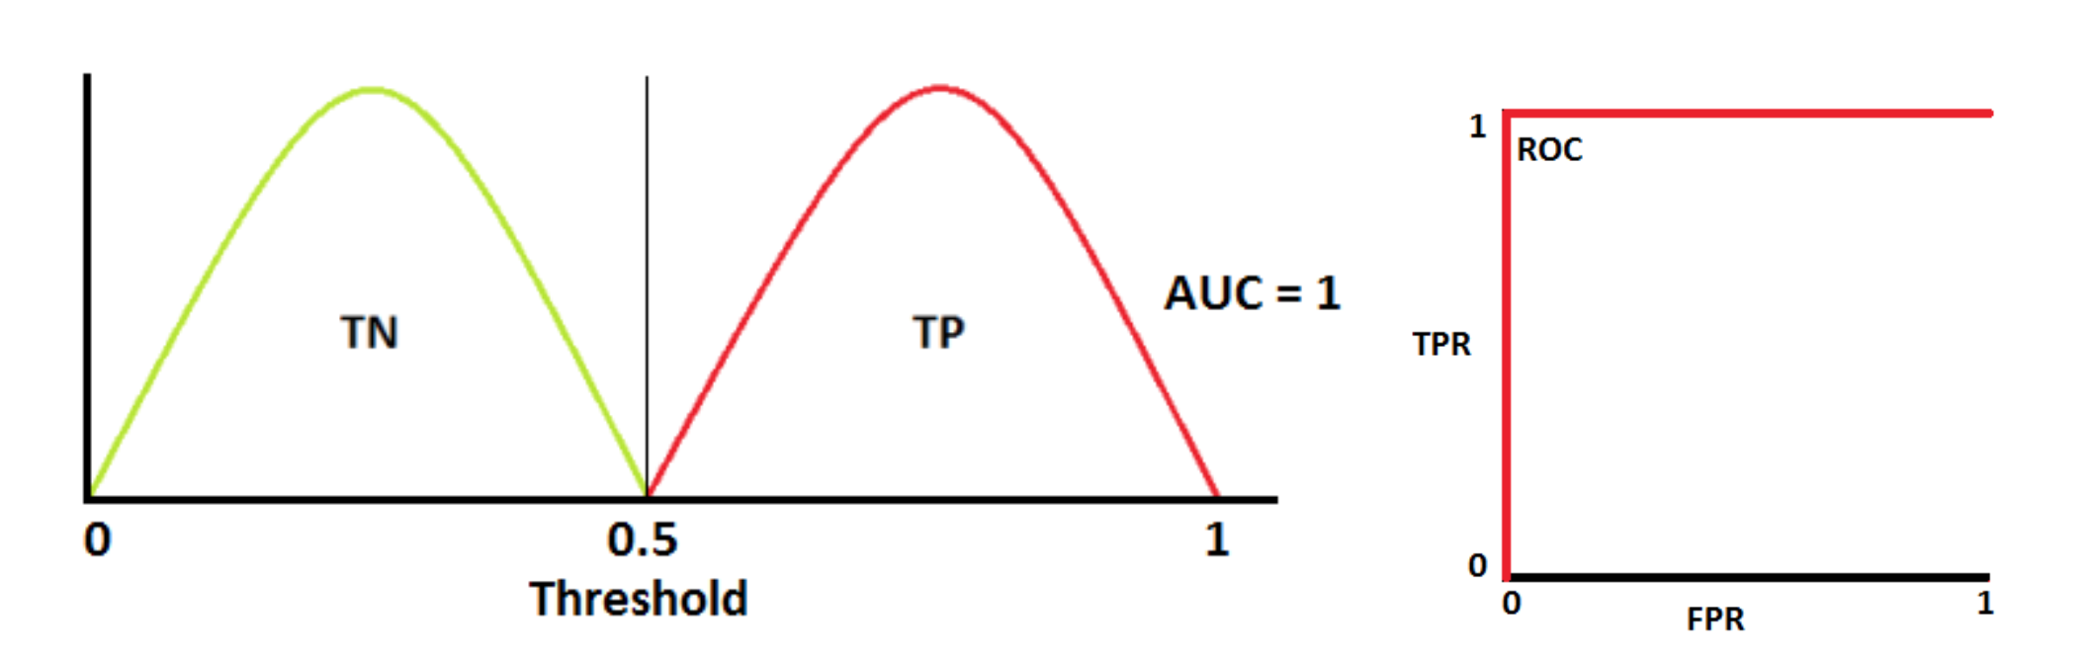
ROC Curves

Slide 23
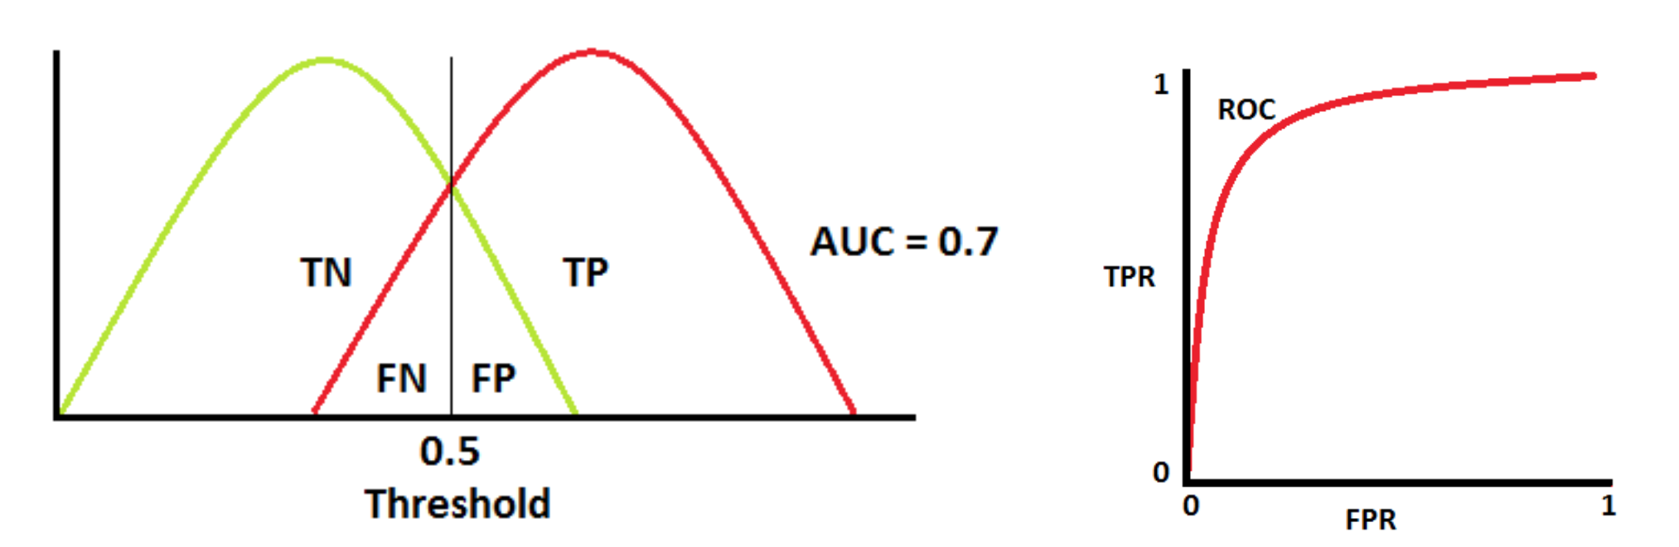
ROC Curves

Slide 24
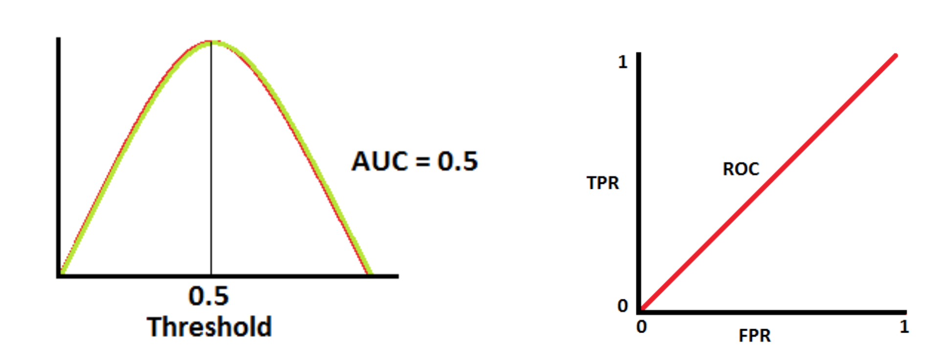
ROC Curves

Slide 25

How much data do you need?

